Slide 1
COEN 146 Computer Networks
Unix/Linux Commands and Overview of C Programming

Slide 2

General Announcements
TA email:
Isaac Wu, ywu4@scu.edu
Rachael Brooks, rbrooks@scu.edu
Demoing & Grading:
Grading will be based on
Whether code works
Programming style
Embedded comments
Observations/answer for questions
Demos are 25% of your final lab score
Late penalties will be 10%
Lab instructions:
If needs to attend other sessions, let TAs know ahead of time
Can finish lab early and just come to demo

Slide 3
Terminal/Remote into the ECC
In general, you need to be running on a linux OS
Recommended to SSH into engineering linux computers
The username and password is the same as your scu email entries
ssh username@linux.dc.engr.scu.edu
Please refer to https://wiki.helpme.engr.scu.edu/index.php/SSH for more information
Get file from and to linux machine:
sftp username@linux.dc.engr.scu.edu
cd : move around
put filename : put file onto remote machine
get filename : get file from remote machine
Remote with GUI access:
Please refer to https://wiki.helpme.engr.scu.edu/index.php/NX_Workstation

Slide 4
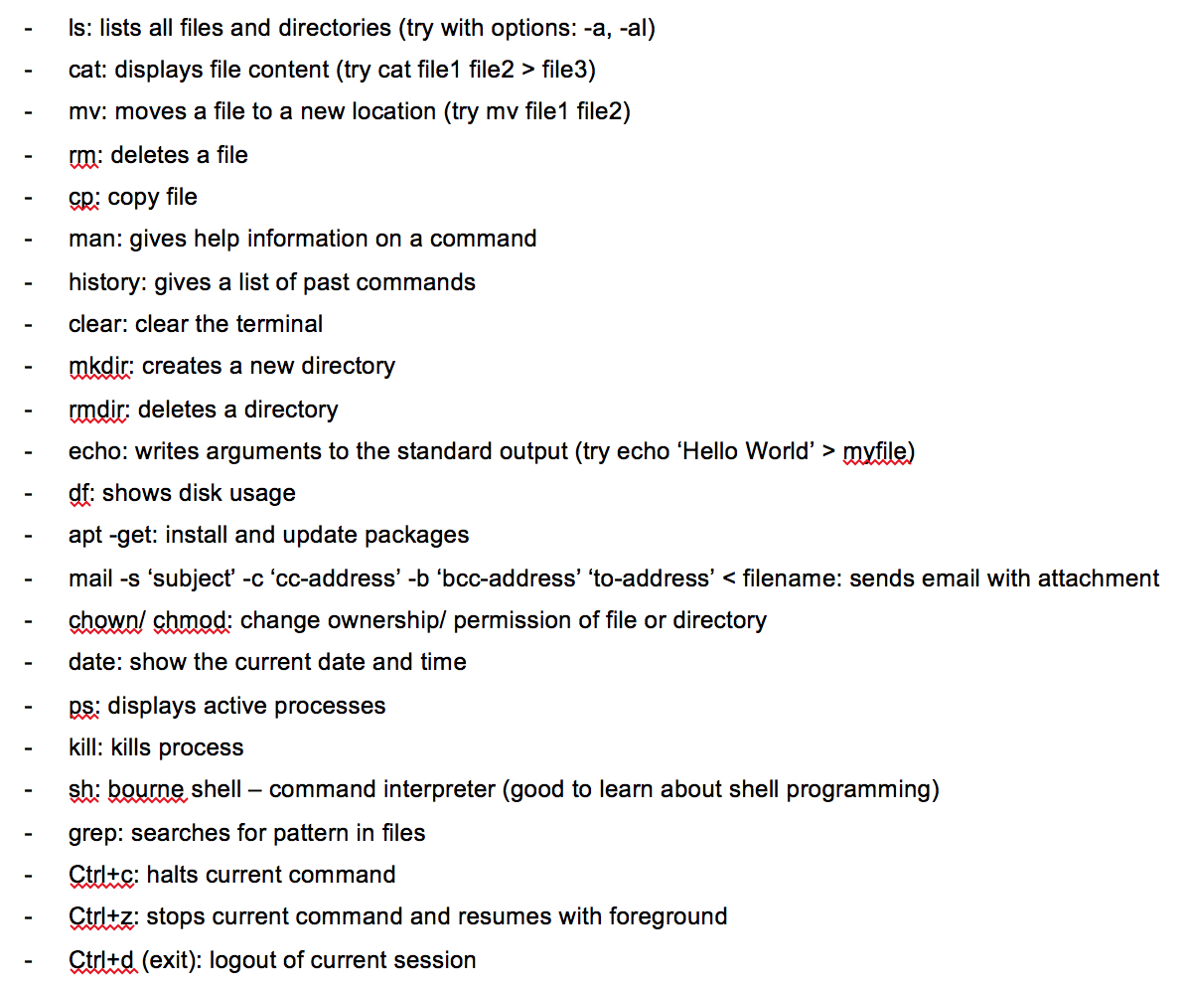
Terminal Basics
To navigate around use cd dir_name
To go to parent folder use cd ..
To learn more about a command, use man
man command
Press q to exit when done reading
Command will work with different options: -a: all, -b: buffer, -c: command, -d: debug, -e: execute, -f: file, -l: list, -o: output, -u: user

Slide 5
Pipe and redirect
Pipe
Send output of one program to input of another
Can be done by using ‘|’
Eg. cat /dev/random | head -c 100000
Redirect
Output redirection can be done by using ‘>’
Can be used to output to a file
Eg. cat /dev/random | head -c 100000 > src1.dat

Slide 6
Generate random file
cat /dev/random | head -c <bytecount> > <outputfile>
cat: read data from a file
/dev/random: a special file that serve as pseudo random generator
head: command that output first part of file
-c <bytecount>: command line option to take <bytecount> bytes

Slide 7
Use Vi editor(optional)
vi filename : open a file
Press i to enter edit mode
Press esc in edit mode to get back to command mode
In command mode
:w : to save
:q : to quit
:wq : to save and quit
:q! : to quit without saving

Slide 8
Remember to have following information
# Name: <your name>
# Date: <date> (the day you have lab)
# Title: Lab1 – task
# Description: This program computes ... <you should
# complete an appropriate description here.>

Slide 9
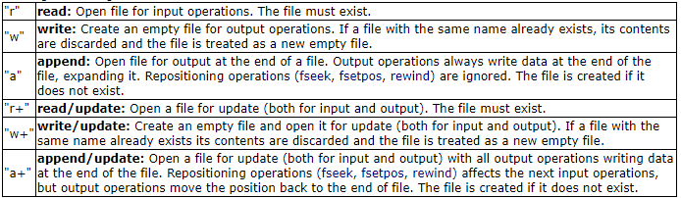
Copy with functions
#include <stdio.h>
FILE *fopen(const char *filename, const char *mode)
size_t fwrite(void* ptr, int size, int n, FILE *fp); or fprintf() (for text files)
size_t fread(void* ptr, int size, int n, FILE *fp); or fscanf() (for text files)
fclose(ptr);
More info: https://www.cplusplus.com/reference/cstdio/fopen/
modes:

Slide 10
Copy with system calls
#include<sys/types.h>
#include<sys/stat.h>
#include <fcntl.h>
int open (const char* Path, int flags [, int mode ]); //access mode flags: O_RDONLY, O_WRONLY, O_RDWR
size_t read (int fd, void* buf, size_t cnt);
size_t write (int fd, void* buf, size_t cnt);
int close(int fd)
More info: https://man7.org/linux/man-pages/man2/open.2.html

Slide 11
Time with clock()
#include <time.h>
clock_t start, end;
double cpu_time_used;
start = clock();
... /* Time consuming process. */
end = clock();
cpu_time_used = ((double) (end - start)) / CLOCKS_PER_SEC;

Slide 12
Threads
#include <pthread.h>
Compile with -lpthread flag
Functions to create threads
pthread_create(pthread_t *thread, pthread_attr_t *attr, void *(*start_routine) (void *arg), void *arg)
pthread_exit()
pthread_join(pthread_t thread, void **retval)

Slide 13
Compile with GCC
gcc filename
gcc -o executable_name filename
If not specified, the output name will be called a.out
To compile a file using pthread, -lpthread flag will be used
gcc -lpthread -o executable_name filename
After compilation, you can execute the file
./executable_name [parameters]

Slide 14
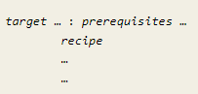
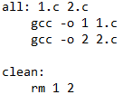
Makefile
Makefile will be useful when you have multiple files to compile.
General format:
To compile all files: make
To clean up: make clean
For more information: go to https://www.gnu.org/software/make/manual/make.html
eg:

Slide 15
Steps to follow
For step 1-4, finish each step in individual .c file
For step 5-6, fill in the calculations for each variable in the template code
Demo the result to TA and submit all .c files.

